Slide 1
Cloud Core – Modern Workplace Services
Ben Stegink

Slide 2

Day Two Rundown
Timeframe | Activity | Engagement
7:30 – 8:00 | Virtual check-in
8:00 – 9:00 | Identity and Devices | Interactive Discussion
9:00 – 9:15 | Break
9:15 – 11:00 | Design Hybrid Identity Environment | Hands On: Group Work
11:00 – 12:00 | Lunch
12:00 – 12:55 | Modern Workplace Services | Interactive Discussion
12:55 – 1:00 | Break
1:00 – 2:00 | Exchange Migration | Hands On: Group Work
2:00 | Wrap Up the Day

Slide 3
































All the services…

Slide 4
Let’s focus on a few key services
Exchange
SharePoint
Lists
Teams
Yammer
“Tasks”
To-Do
Planner

Slide 5
New to Exchange and Outlook
New Outlook web interface
Outlook + Microsoft To-Do
APIs added to Graph
Improved integration with Microsoft Teams
Calendars, booking meetings
Rapidly adding features to Outlook Mobile
Teams Meeting, Shared Mailbox Access
Minor Improvements, messaging focus is on Microsoft Teams

Slide 6
Exchange Hybrid Configuration
Common configuration medium to large or organizations
Primarily used for migrations
Hybrid can be EOP + Exchange On-Premises
Exchange 2007 +
Must have minimum of one Exchange 2010 server
Notes:
An exchange 2007 farm with a single Exchange 2010 server is supported for hybrid (Mailbox, Hub Transport and Client Access roles installed)
- https://docs.microsoft.com/en-us/Exchange/hybrid-deployment-prerequisites

Slide 7
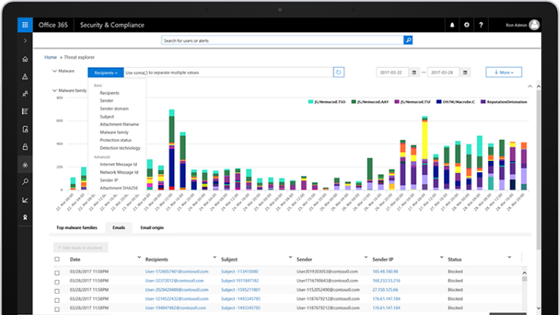
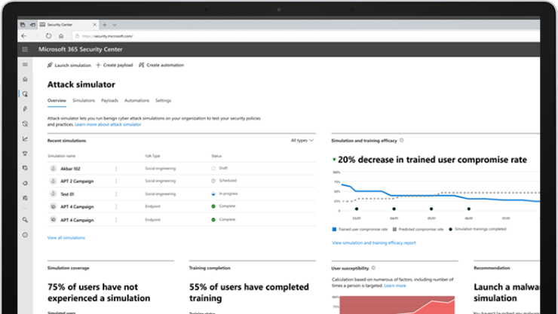
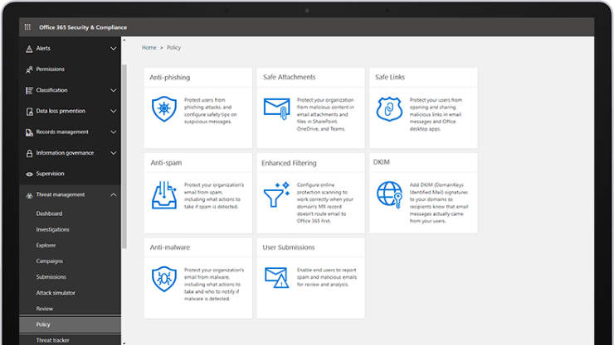
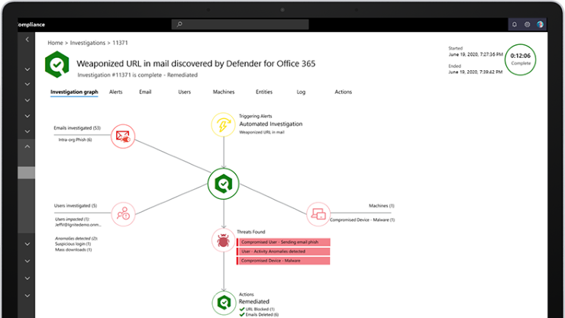
Email Security
Native protection for Office 365
Leverage AI and automation
Complete solution
Investigation and hunting
Awareness and training
Prevention and detection
Response and remediation

Slide 8

Microsoft Internal SharePoint landscape
Office 365 Sites & Groups
On-premises
Specialized needs & testing
Online
Everything comes together
Self-service & managed
Self-service, now over 3 petabytes of data in SPO + ODB spanning 3 geos
<6K sites and portals
179K Office 365 Groups + 74K non-group SharePoint sites + 238K OneDrive for Business
Regional collaboration farms serving:
Team, portal, extranet sites
Users, groups and countries
SharePoint Sites
233K users
253K total sites
179K groups
74% Modern Sites
125 countries
Communication Site Adoption at 57%
Hybrid
On-premises shared services: Search, User Profiles, Taxonomy
Office 365 shared services: Search, User Profiles, Taxonomy, Office Graph

Slide 9
Governance: IA for Sites, Office 365 Groups, and Teams
Company
Hub Site
Division
+
Team site
Team site
Communication site
Team
Notes:
Hub Site
Communication Site
Team Site
Teams Site
No Office 365 Group
Office 365 Group
Team
Communication Site
- No Office 365 Group

Slide 10
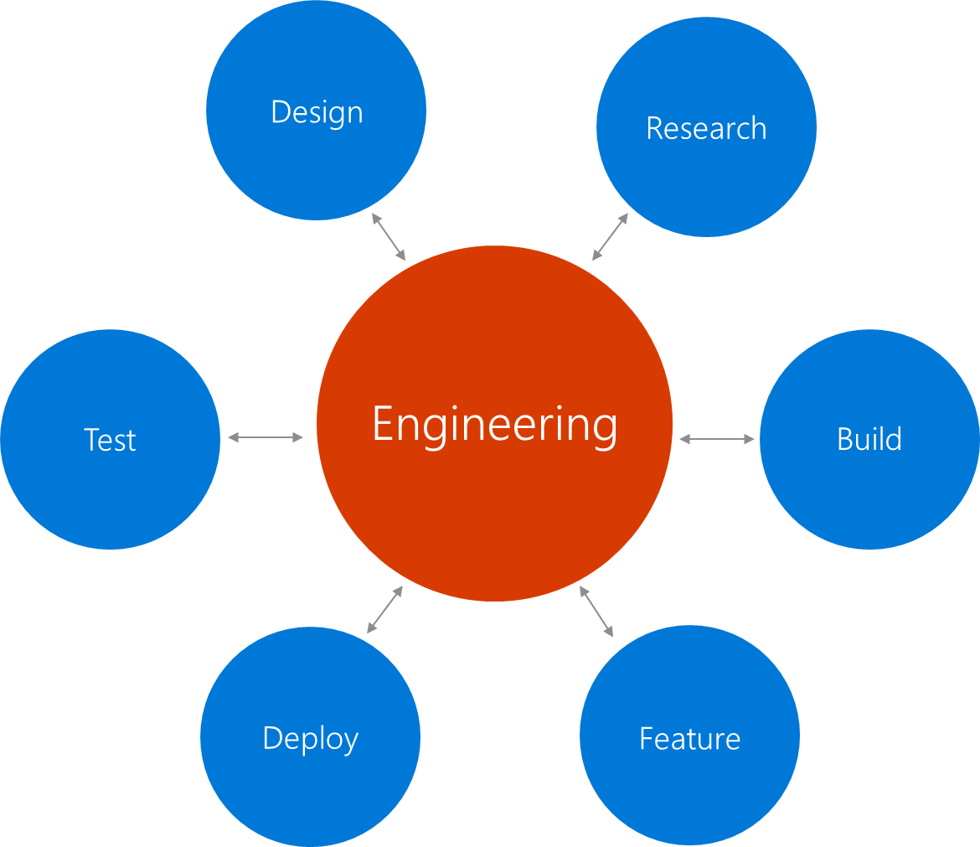
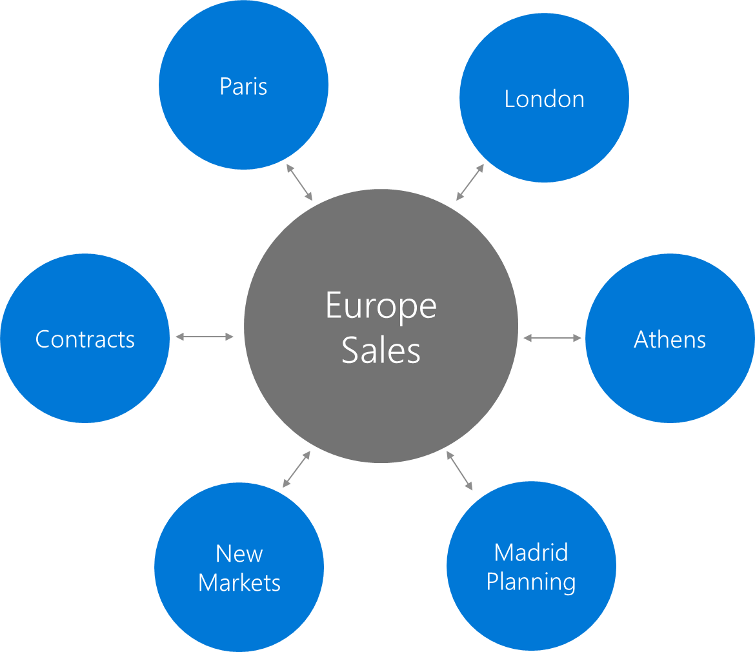
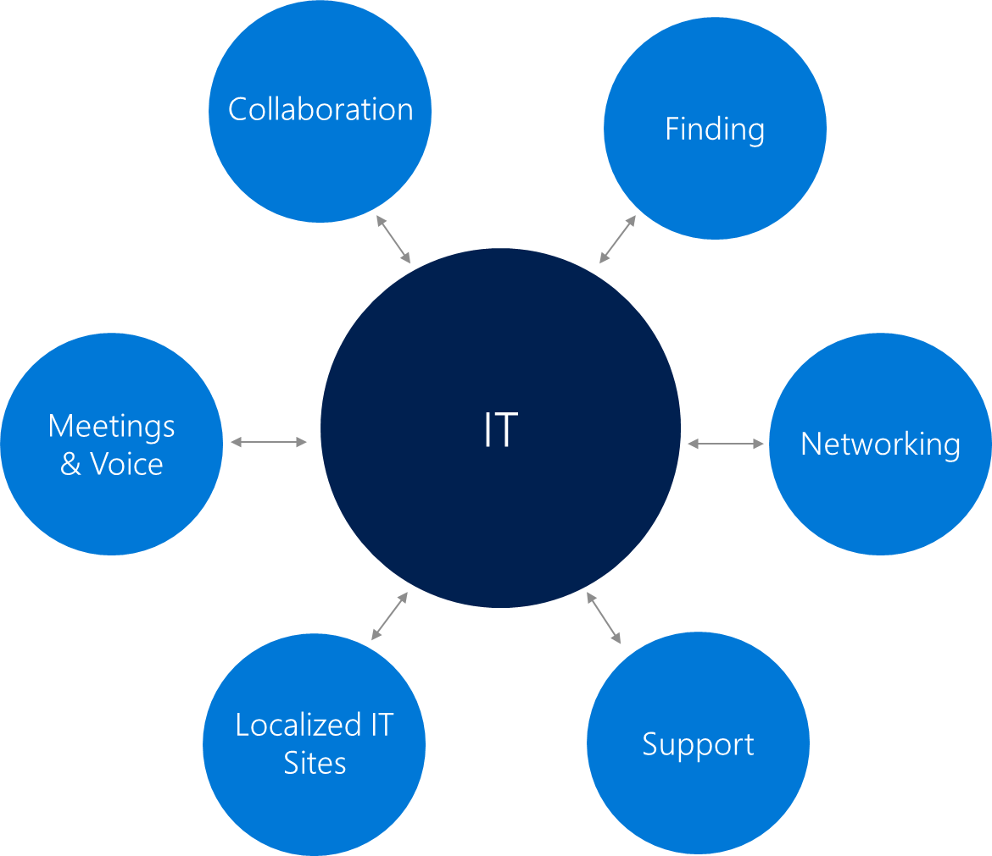
Microsoft CSE (IT) approach to site modernization
Organization
(Examples: Division, Product line, projects, communities)
Location
(Examples: Sales regions, location-based offices)
Function
(Examples: HR, Finance, PR, Legal, IT, Corp Comms)

Slide 11
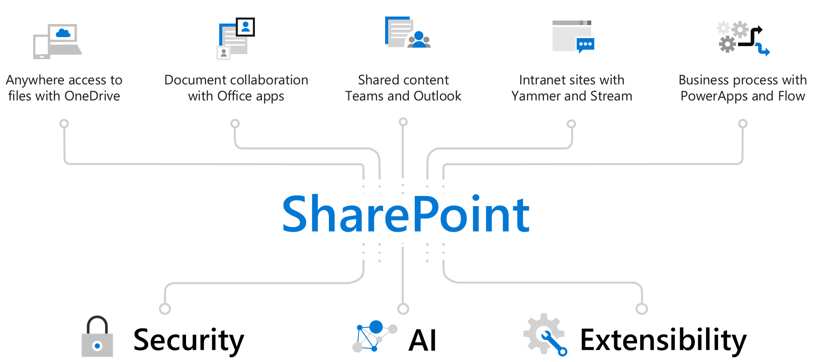
Modern SharePoint

Slide 12
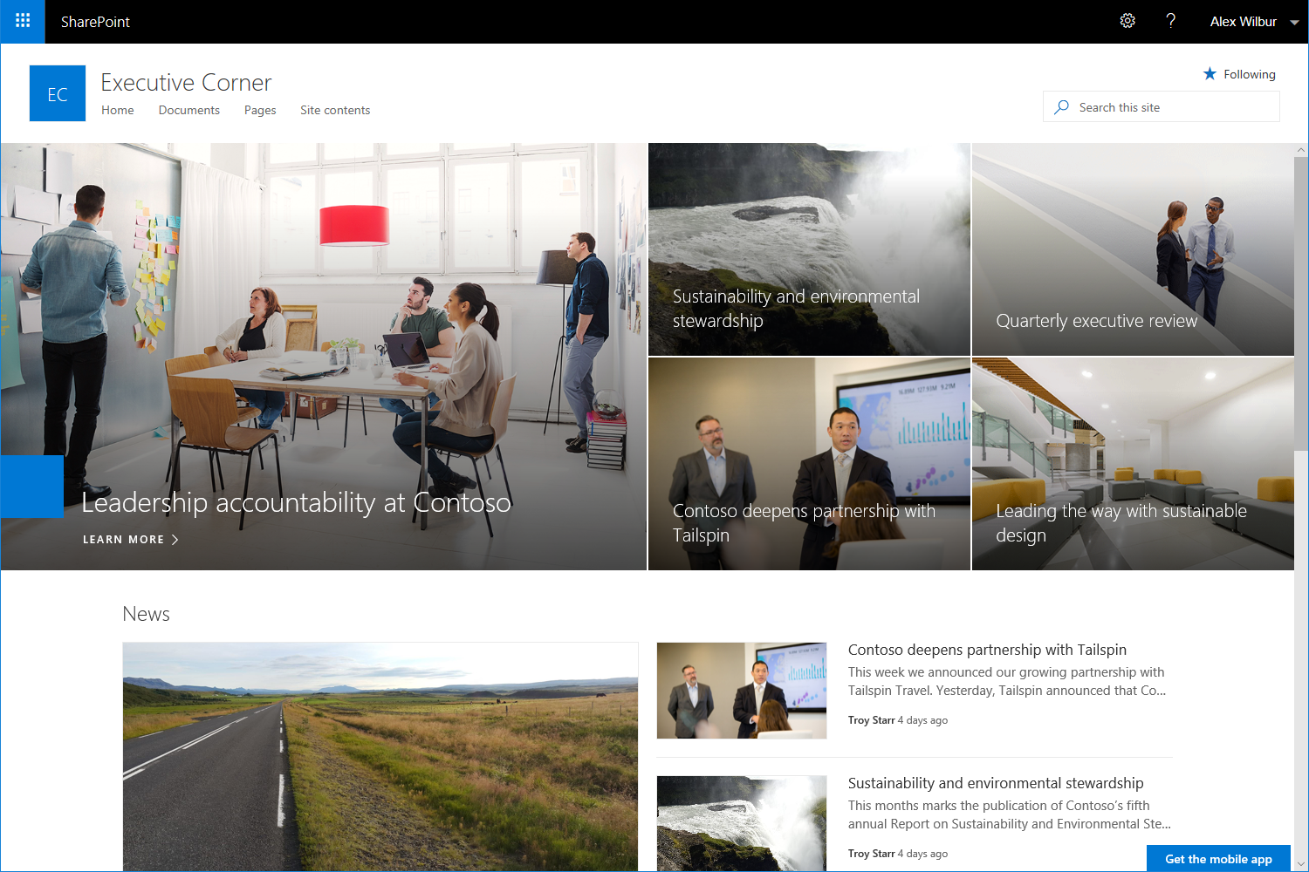
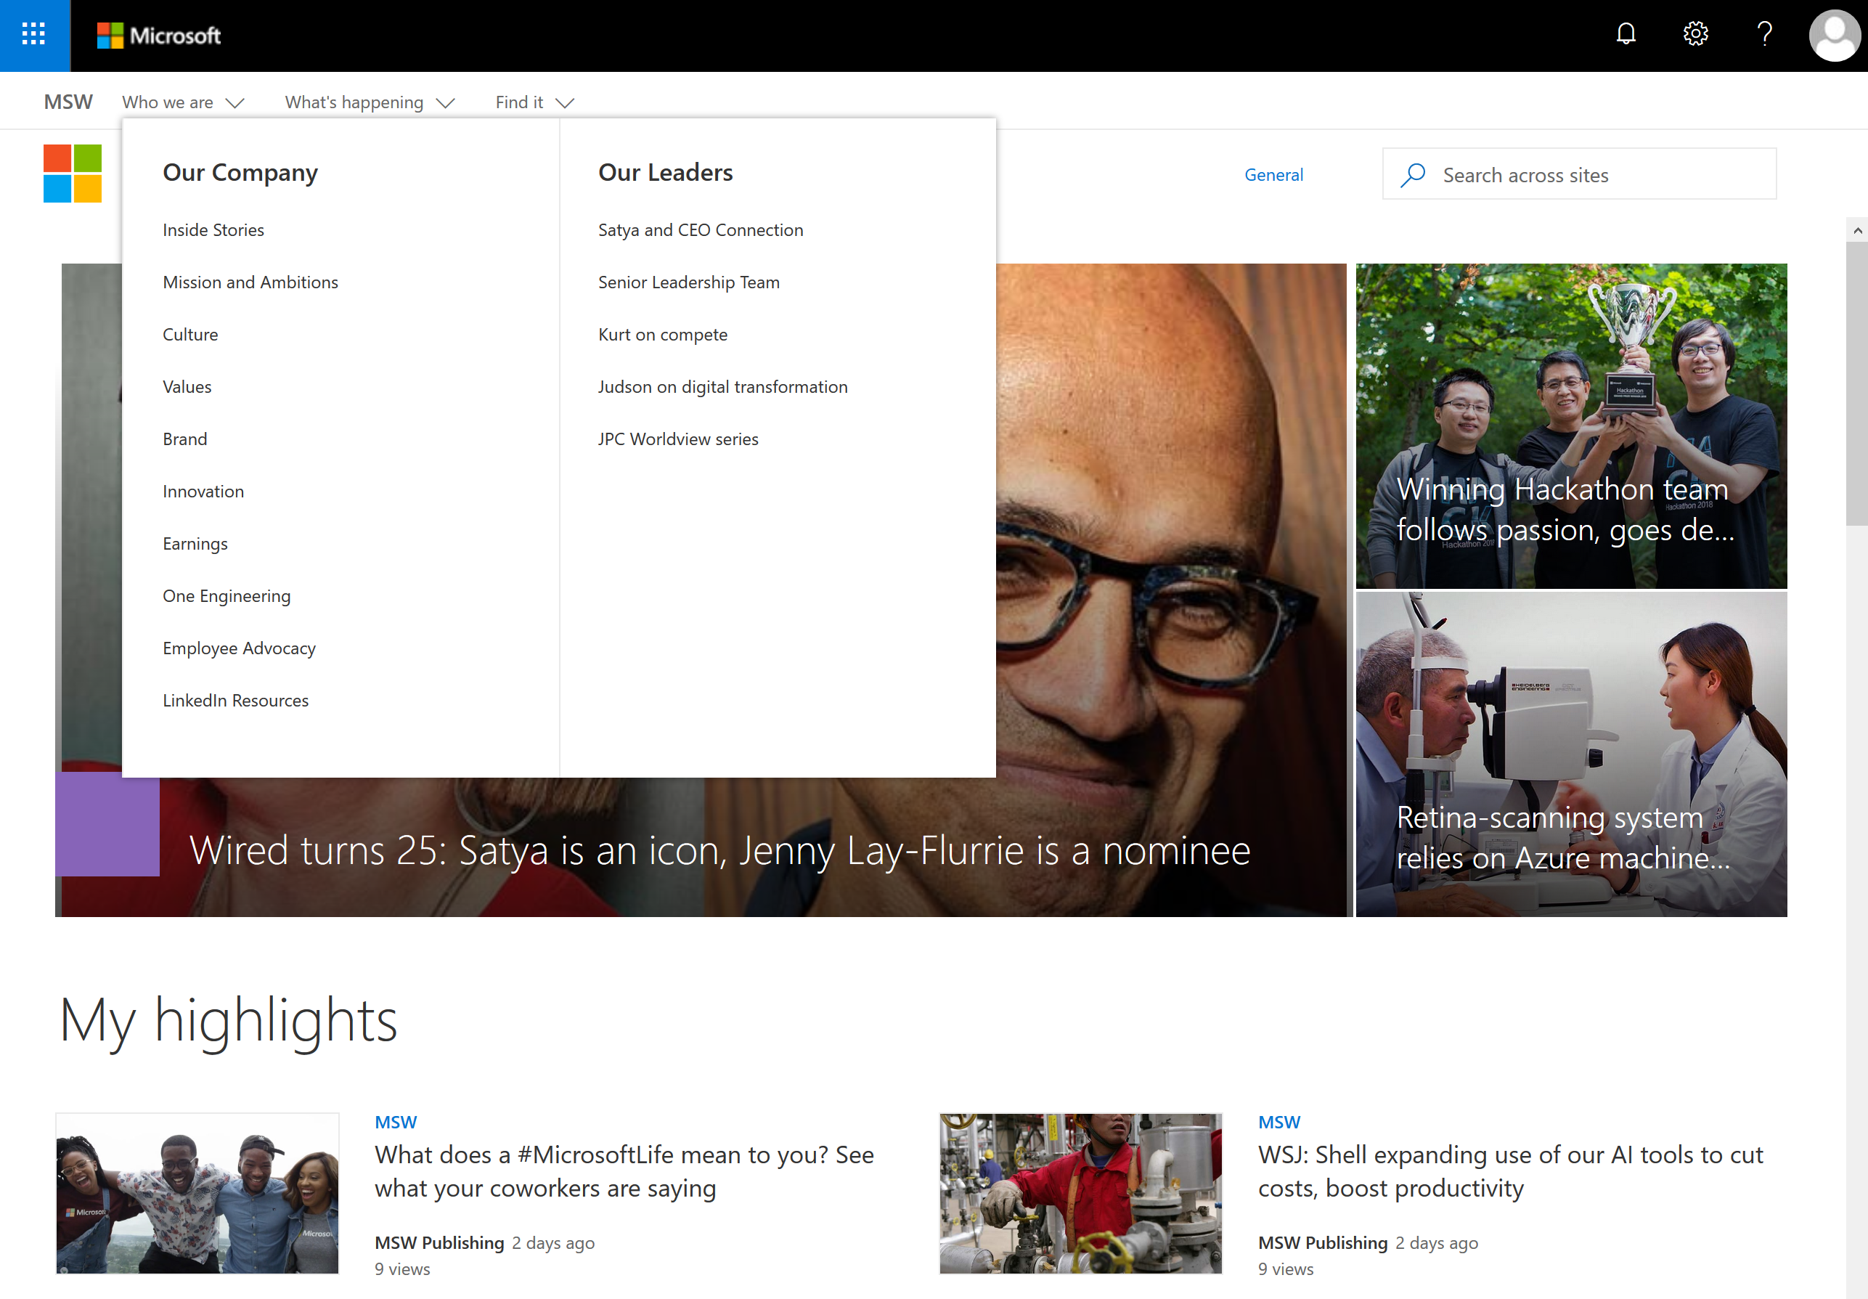
SharePoint Team & Communication Sites
Beautiful, dynamic site to reach broad audience
Keep your organization informed and engaged
Hub sites, Search, Megamenu

Slide 13
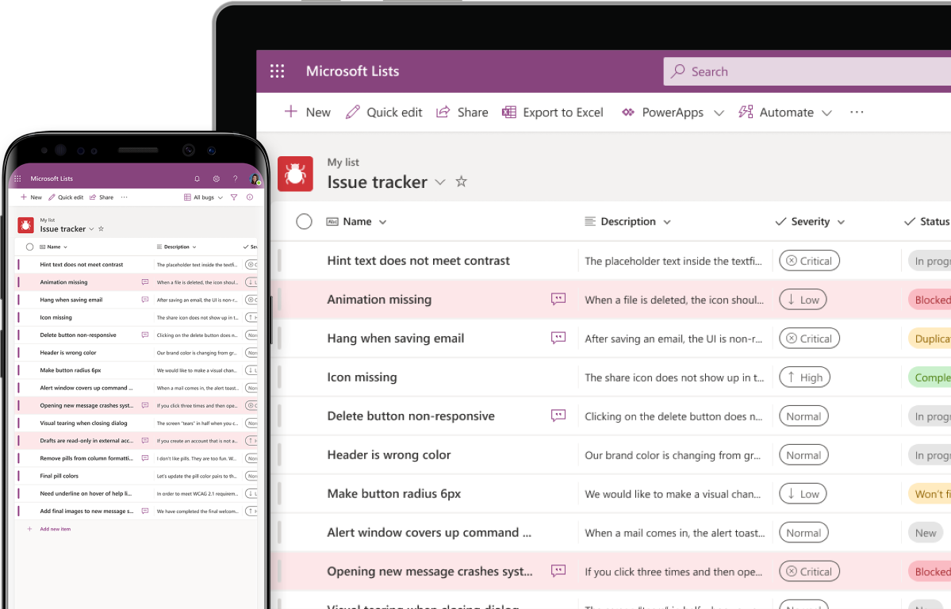
Microsoft Lists
Create blank lists or from templates
Central location for all lists
Simplified filtering experience
Format columns
Details pane gives you more information without leaving the list view

Slide 14
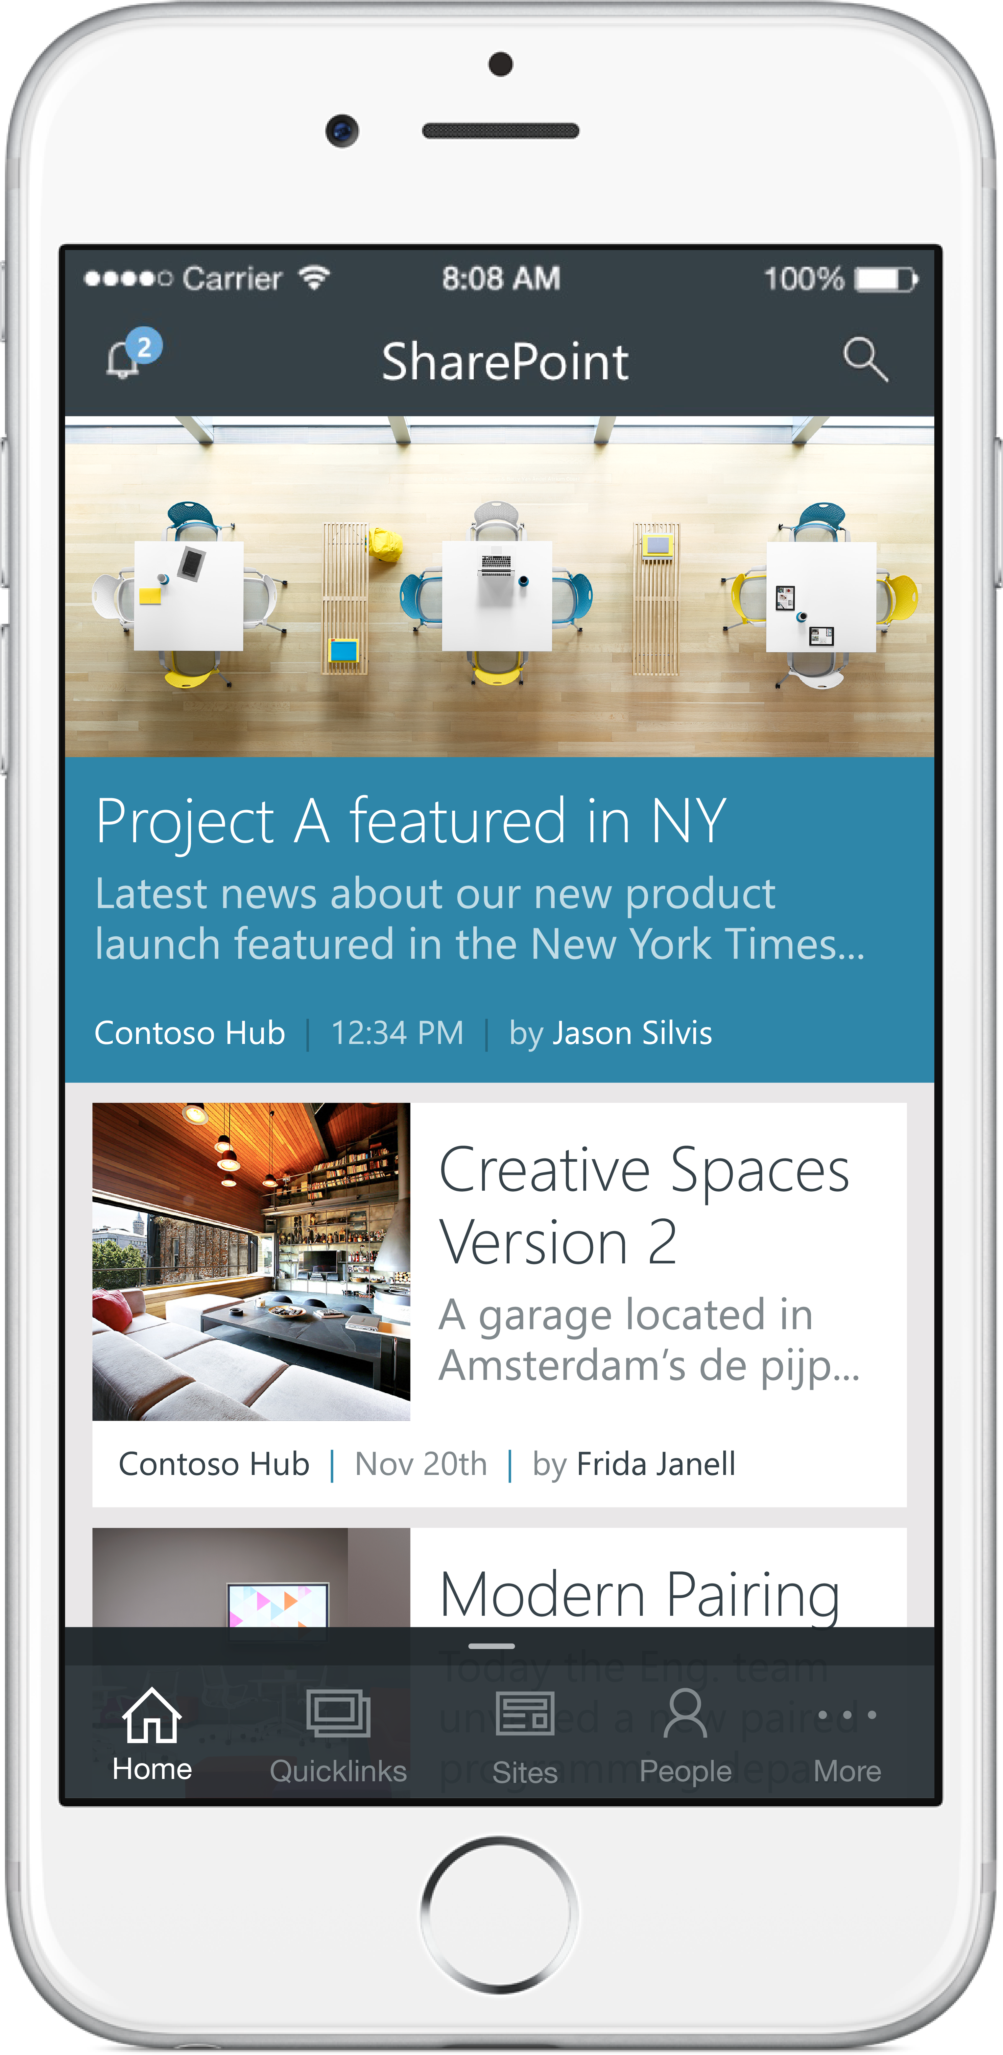
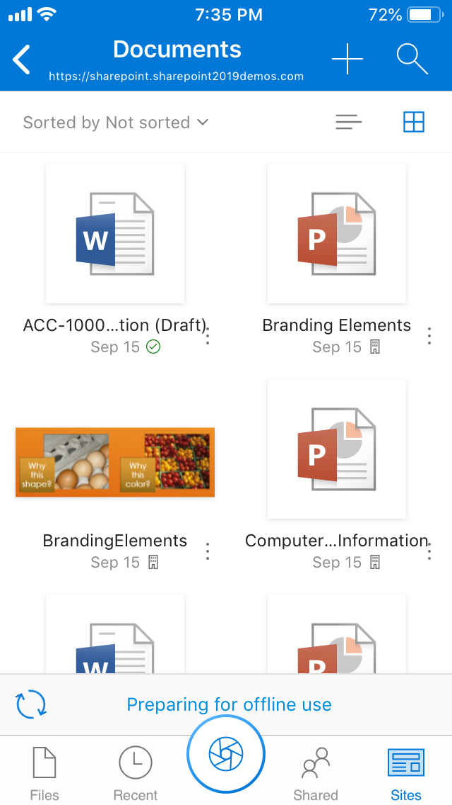
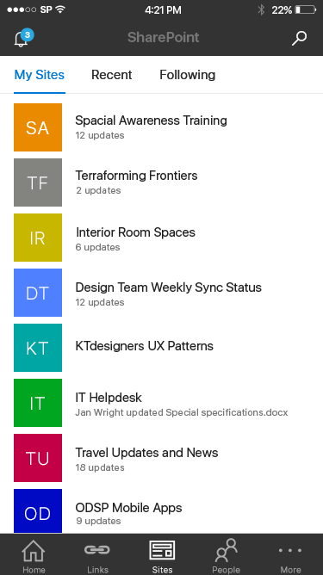
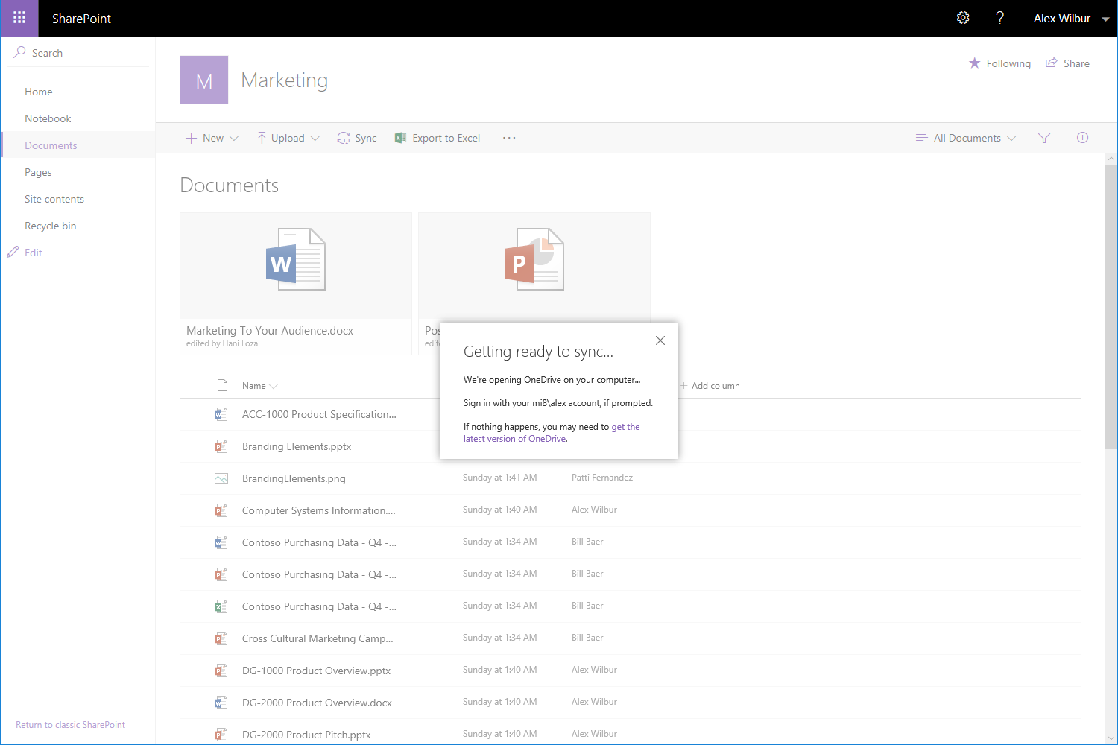
OneDrive
Sync client vs. online service
Enterprise File Sync and Share
Personal documents and files
Sync OneDrive and SharePoint locally
Files On-Demand

Slide 15
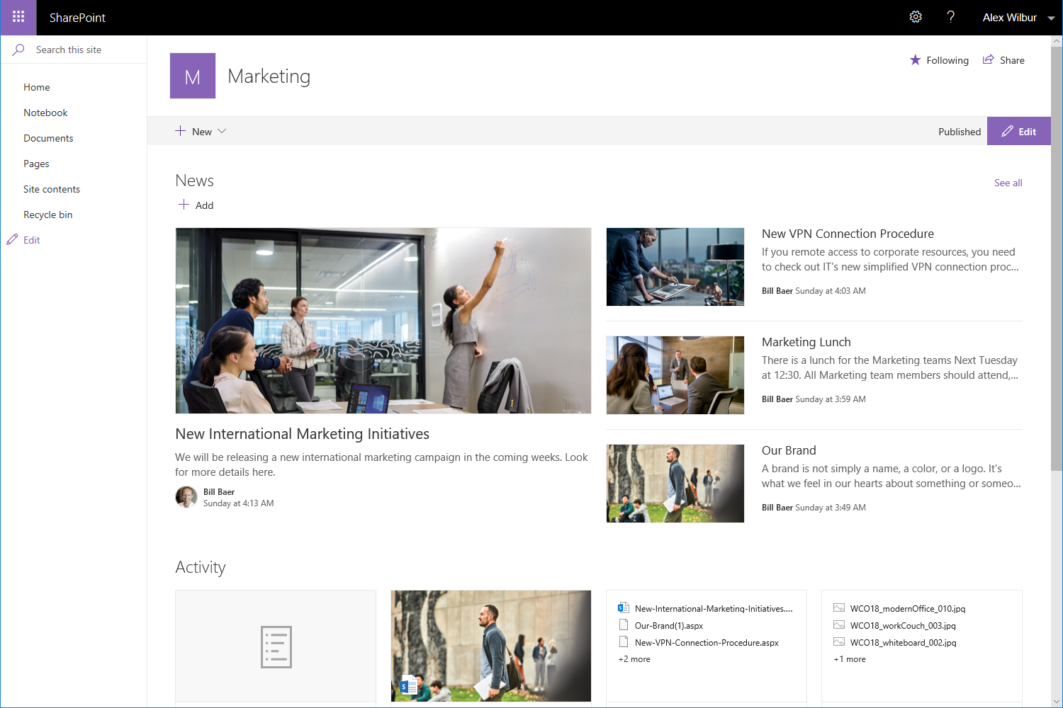
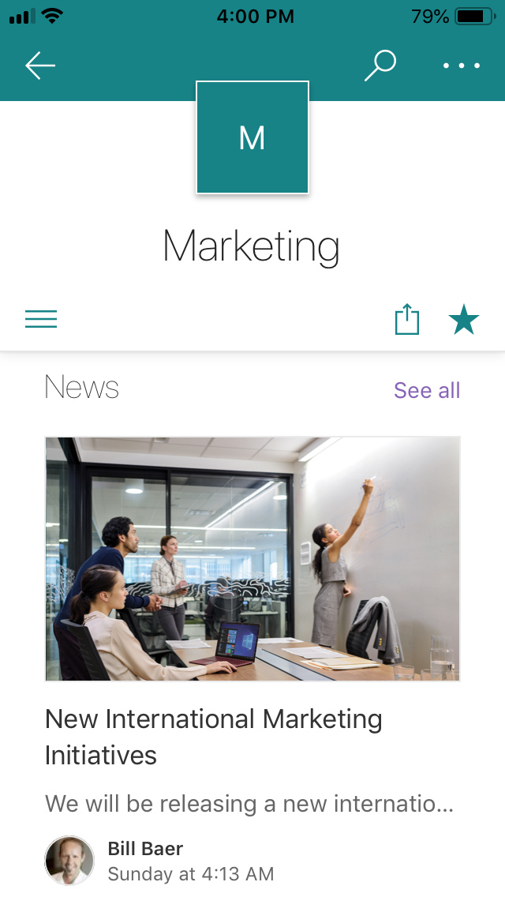
Mobile
Work on every device
Get SharePoint on the go with the SharePoint Mobile App
Sync files on the go with OneDrive
Edit files on mobile via Office app(s)

Slide 16
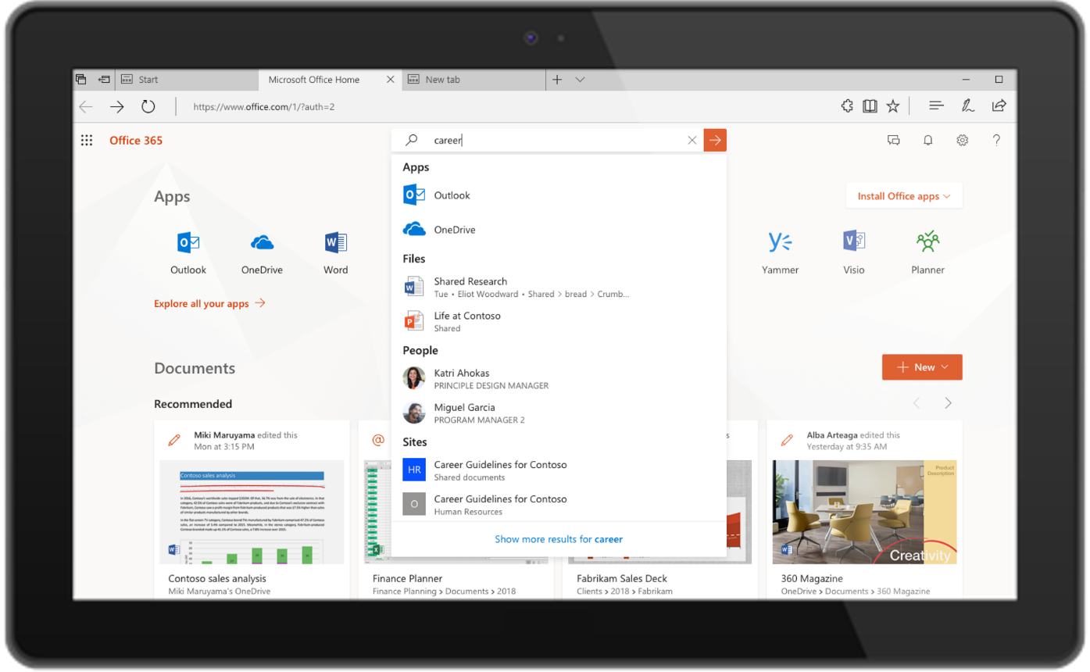
Microsoft 365 Search
Modern search experience
Type ahead contextual results in search box
Single search experience across the entire modern desktop experience
Improved contextualized search
Microsoft Graph connectors
Notes:
Contextualized search
Start your search with a person, then search for content associated with that person
Microsoft Graph connectors
- Surface search results from other third-party services that integrate with Microsoft 365

Slide 17
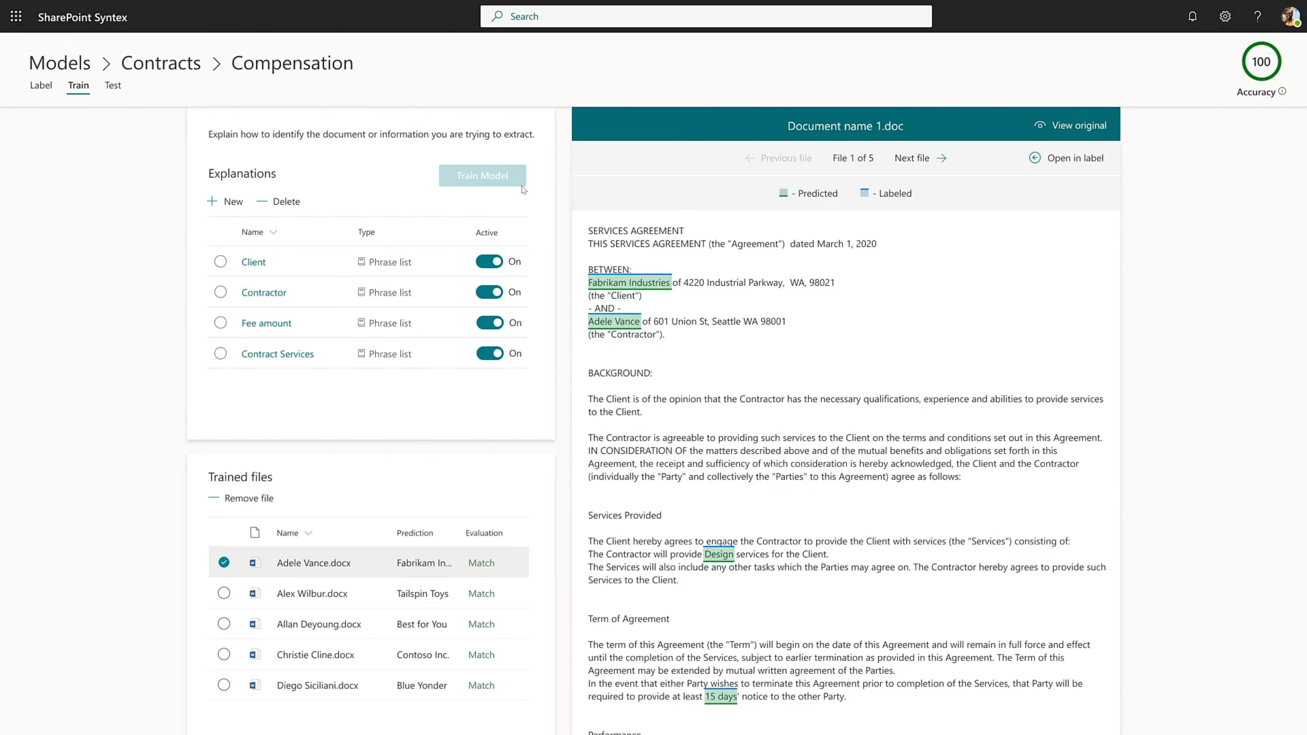
SharePoint Syntex
Built AI models and capture content with no code
Add content as metadata
Improve Search
Apply sensitivity and retention labels
Create workflows from data

Slide 18
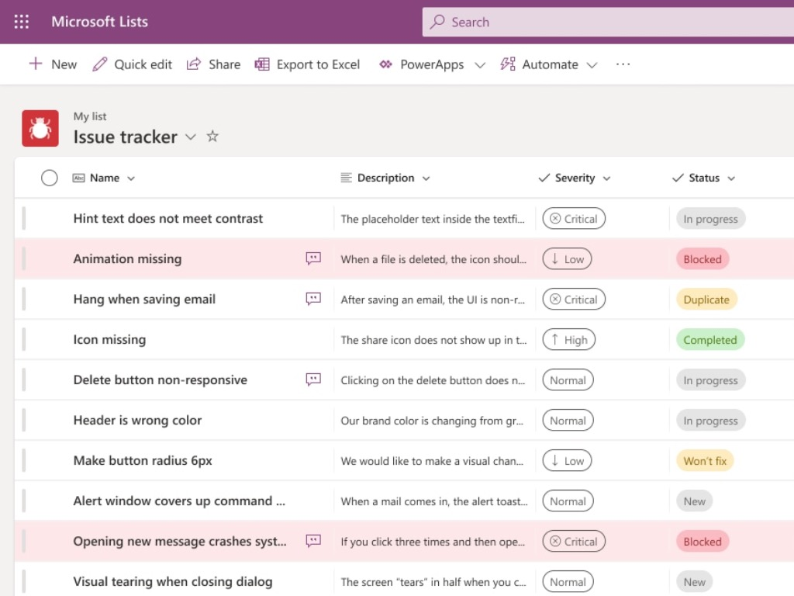
Project Nucleus
Performance improvements for Microsoft Lists
Sync lists to your local device
Offline browsing and editing of lists

Slide 19
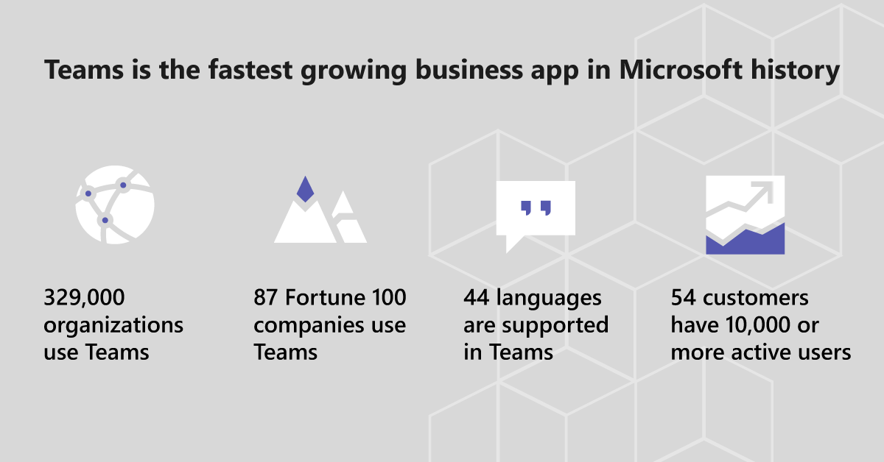
In Q2 2020, more than 200 million Microsoft Teams meeting participants in a single day, generating more than 5 billion meeting minutes. Teams now has more than 75 million daily active users

Slide 20

Microsoft Teams runs on Microsoft 365 Infrastructure
Teams clients
M365 and Azure AD Admin Tools
Controls for Groups, Identity, Licenses, Access
Security & Compliance Admin Tools
Controls for managing Security & Compliance across M365
Teams Services
Skype Infrastructure
Teams Admin Tools
Controls for managing communications and Teams specific features
Office 365 platform and services
Azure

Slide 21
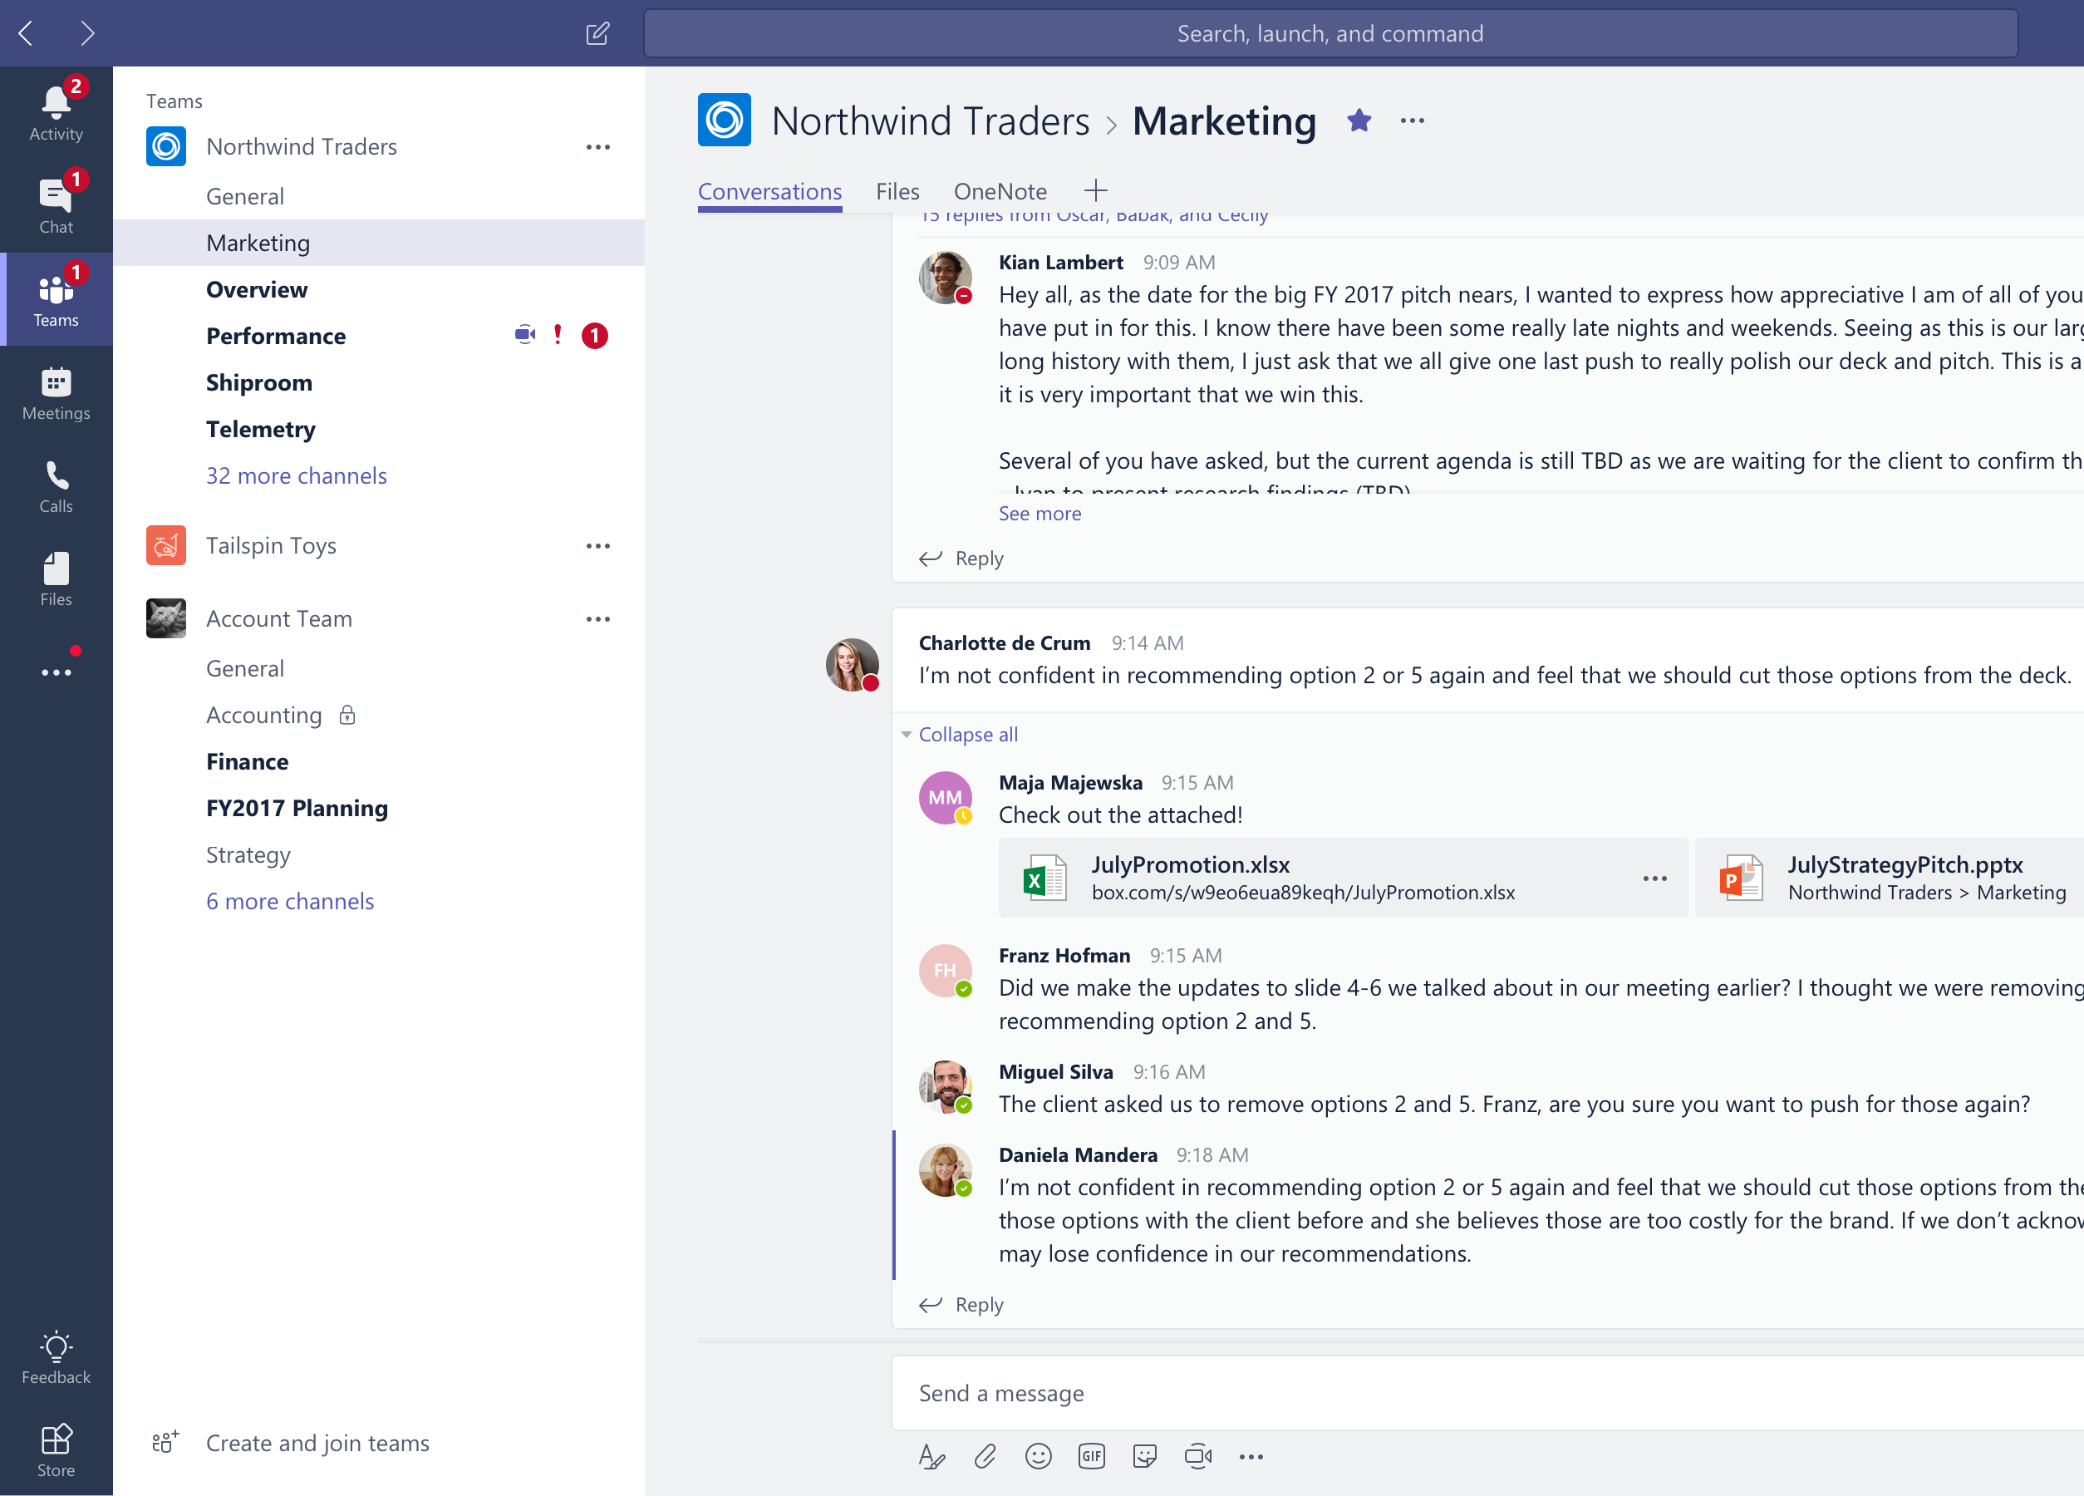
Collaborate with integrated Office 365 apps
Quick access to the apps you love and are familiar with
SharePoint
Office Apps
Stream
Planner
Power Automate & Power Apps

Slide 22
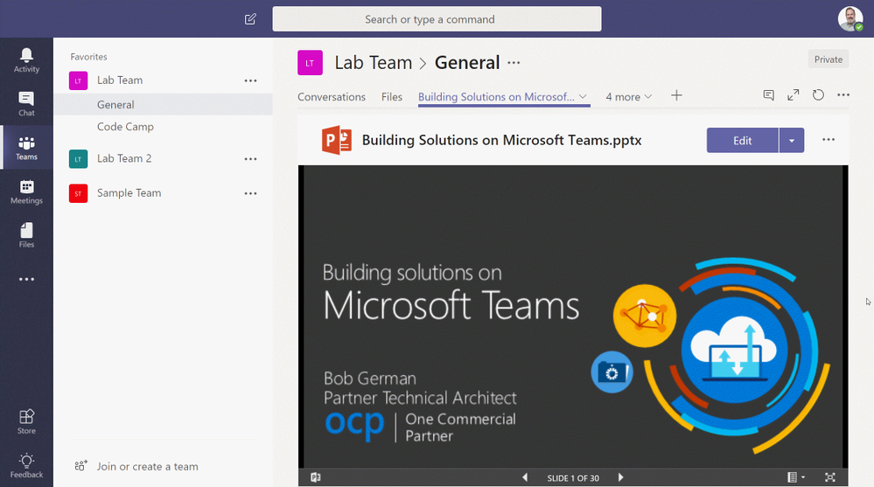
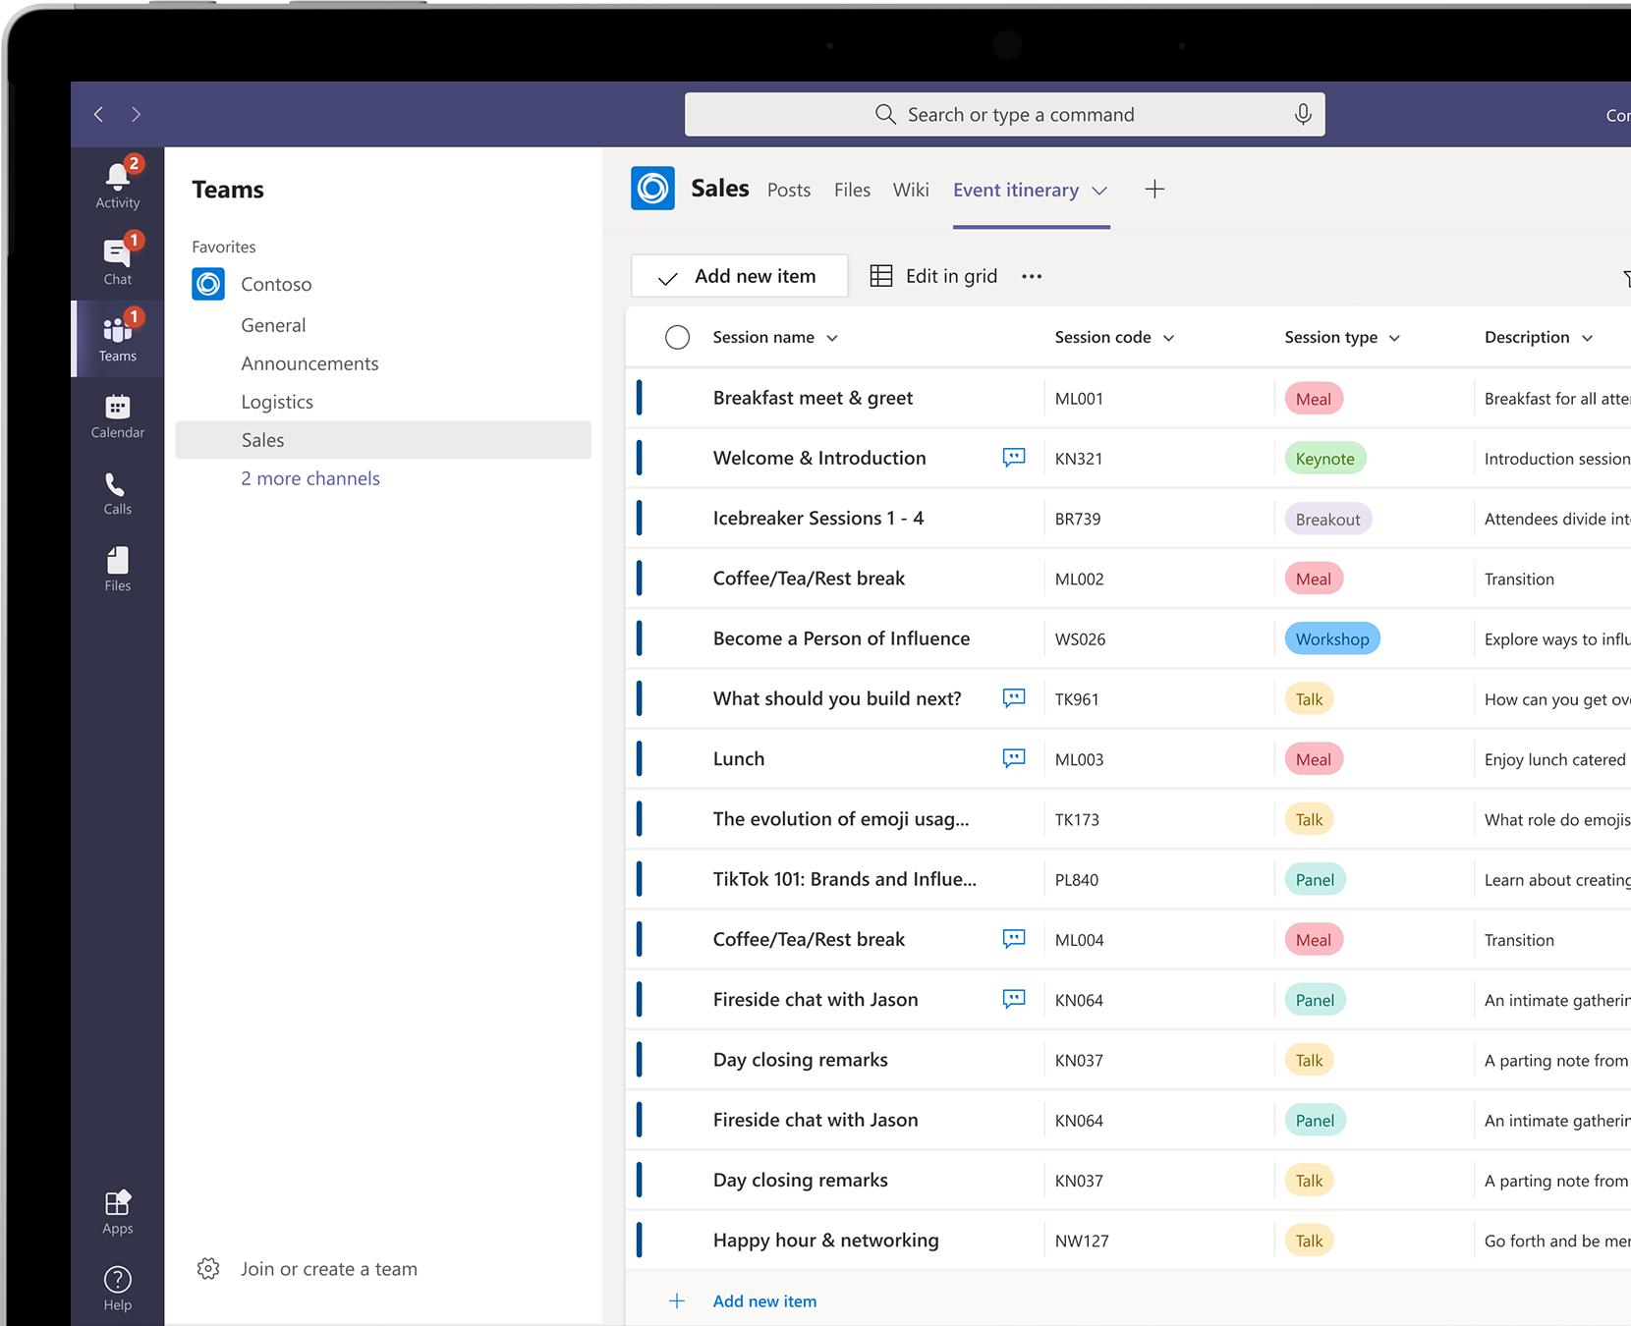
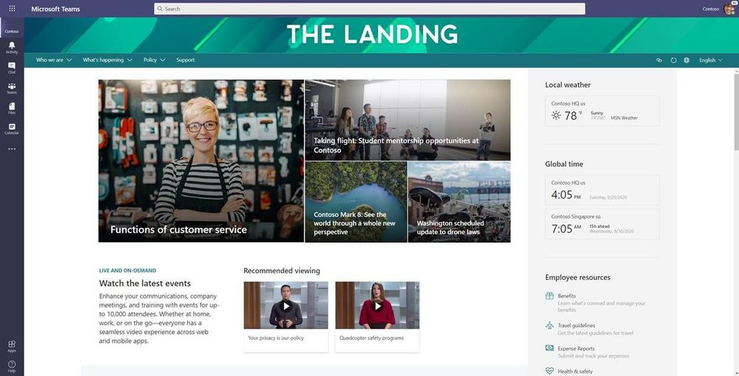
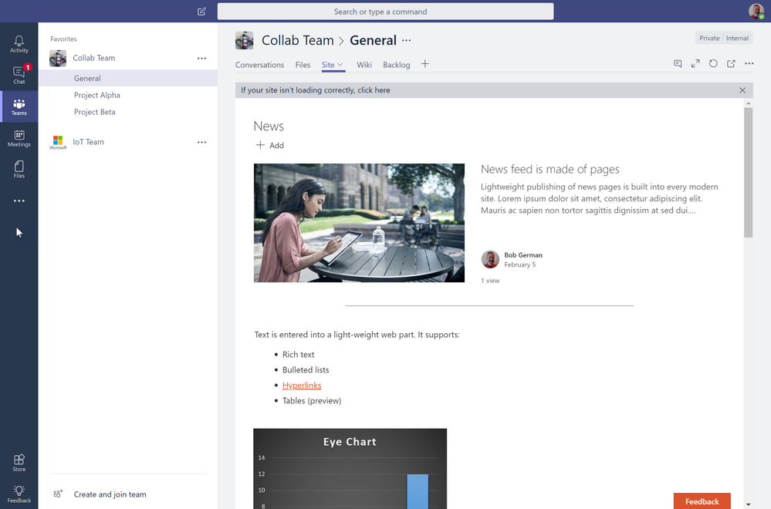
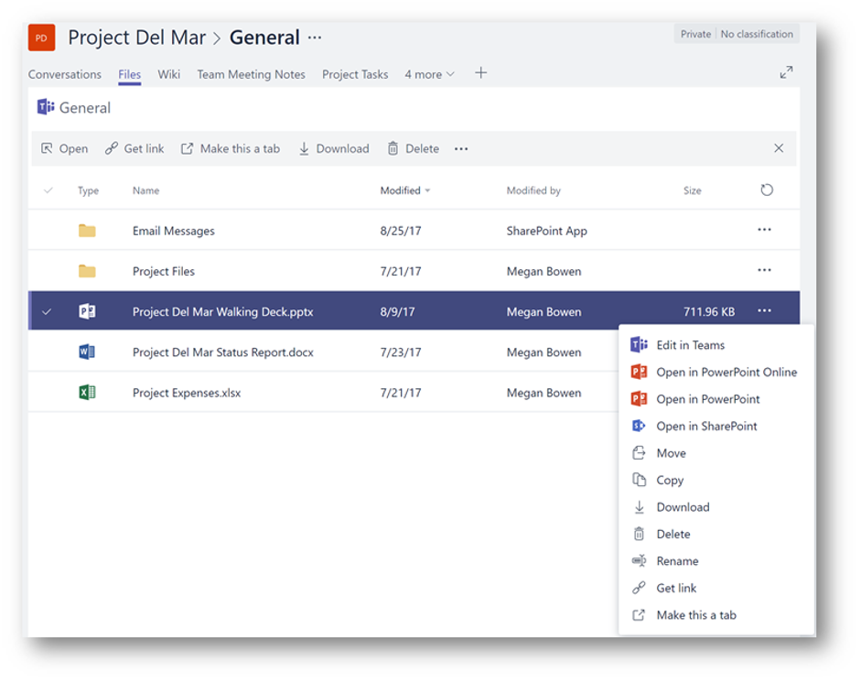
SharePoint + Teams
SharePoint Home App
Files
Pages
Lists

Slide 23
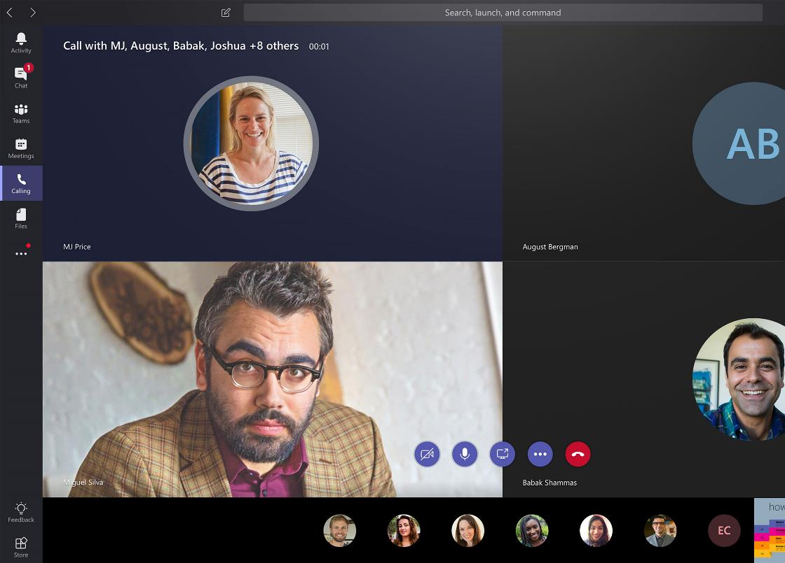
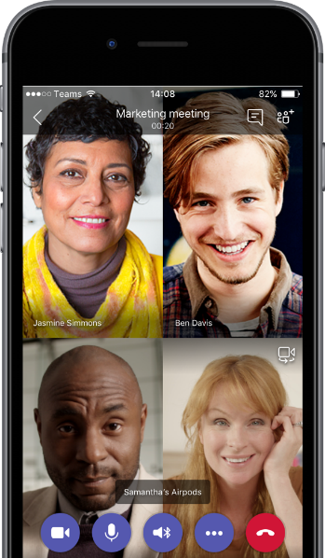
Communicate through chat, calling, and meetings
Communicate without effort and keep your team in the know
Connect with anyone through Phone System and Calling Plans
Meet anywhere, Meet with Intelligence, and Meet with Confidence
Desktop, Web, and Mobile

Slide 24
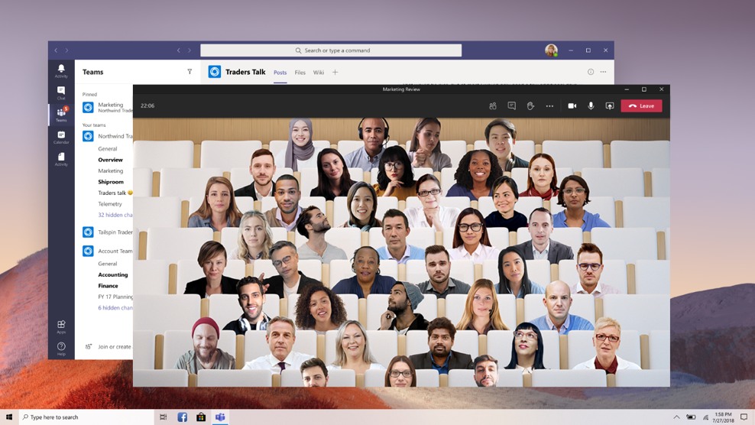
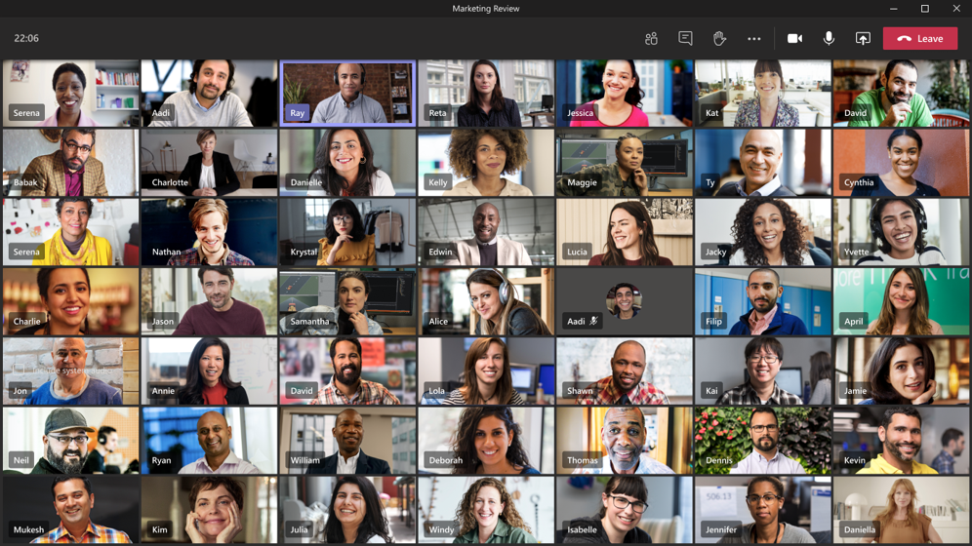
New Meeting Experiences
Together Mode
Large Meetings
Spotlight Video

Slide 25

Phone System
Replace traditional PBX with Office 365
Unify your global phone systems in Office 365
Provide a complete voice solution in the cloud.* Reduce reliance on traditional PBX systems and on-premises hardware
Simplify IT
Increase agility and consolidate management with rapid provisioning, reporting, and diagnostics of voice services in Office 365
Scale globally
With phone system, you can harness the Microsoft network and data centers worldwide, and get the power of the Microsoft cloud wherever your business goes
*A complete voice solution is possible with a combination of Phone System, Calling Plans, and/or Direct Routing

Slide 26
Calling for the Cloud
Office 365
Modern Workplace
Microsoft Teams
Phone System, when paired with Microsoft Calling Plans and/or Direct Routing, provides a full business calling experience for Office 365 users in Teams on a global scale
PBX
Phone System
PSTN dial tone
Microsoft Calling Plans
Direct Routing in Teams
(Telco Calling Services)

Slide 27
Calling Plans
Bring the benefits of the cloud to your phone system
Rapid provisioning
Procure and assign phone numbers in minutes, everywhere Microsoft offers service, with no on-premises equipment
Number porting and enhanced 911
Use your existing phone numbers with Microsoft calling plans, and meet E-911 and other legal obligations
Local, long distance and international calling
Reach the people important to your business, with a choice of calling plans
Microsoft Calling Plans Availability Europe - Belgium, France, Germany, Ireland, Netherlands, Spain, UK North America – US, Puerto Rico, Canada
3rd Party Calling Plans Availability Australia (Telstra)

Slide 28
Yammer = Communities
Build Communities
Share Knowledge
Engage Employees
Integrate with Teams, SharePoint, and Outlook
Bring messages to people where they are
Notes:
Communities = Connect & Engage People
Feed
Share Information
Announcements
Pinning Announcements
Feature Announcements
Praise
Hashtags & Topics across communities
Questions popup out in the feed. Answer can be marked as best answer and will be pinned
Crowd sourcing ideas

Slide 30
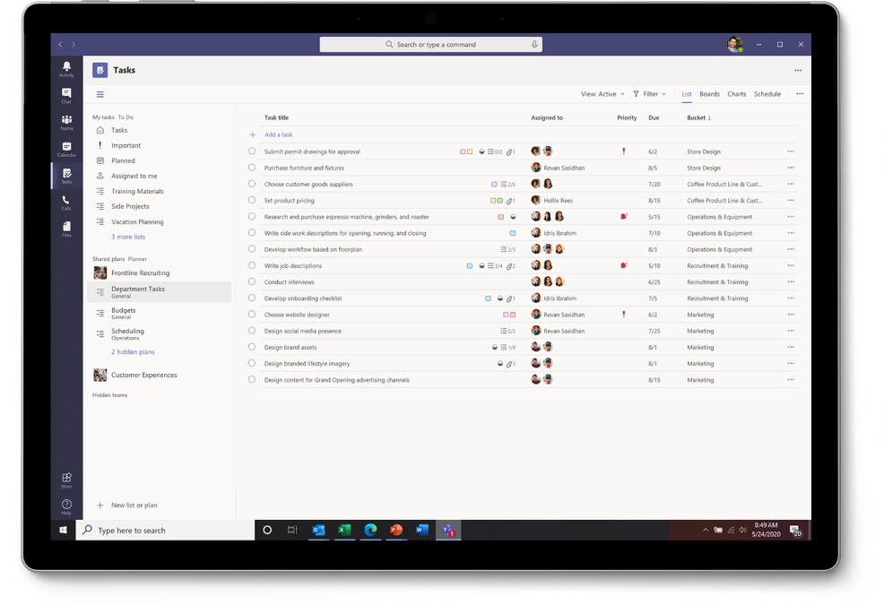
Tasks in Teams
Teams App to keep collaboration in one place
Roll of up tasks from other Microsoft 365
Planner
Outlook / To-Do

Slide 31
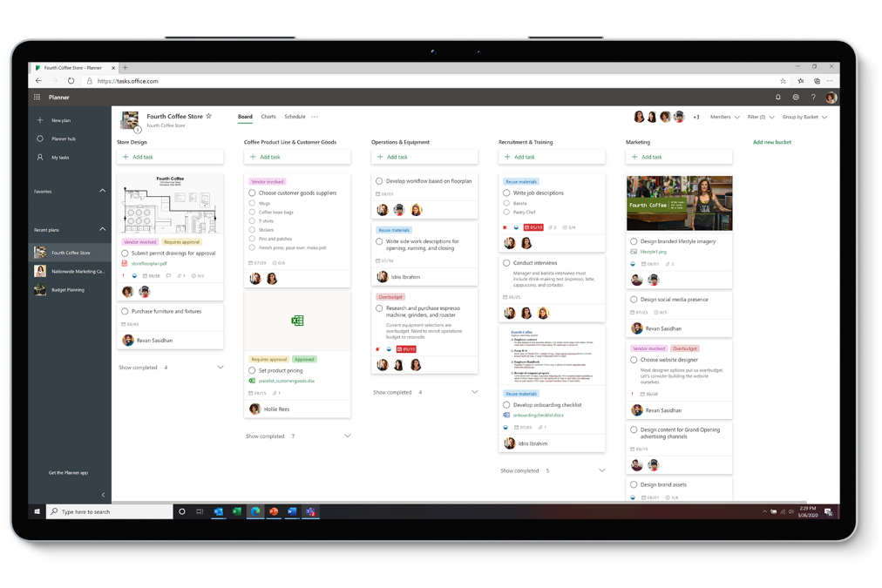
Planner
Team Task Management – Not Project Management
Stand-alone or in Teams
Mobile Apps

Slide 32
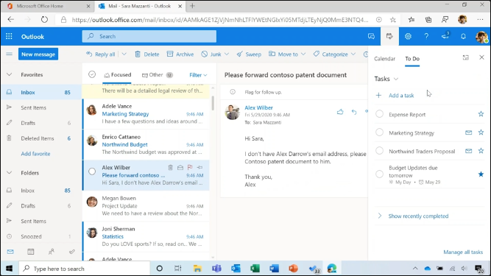
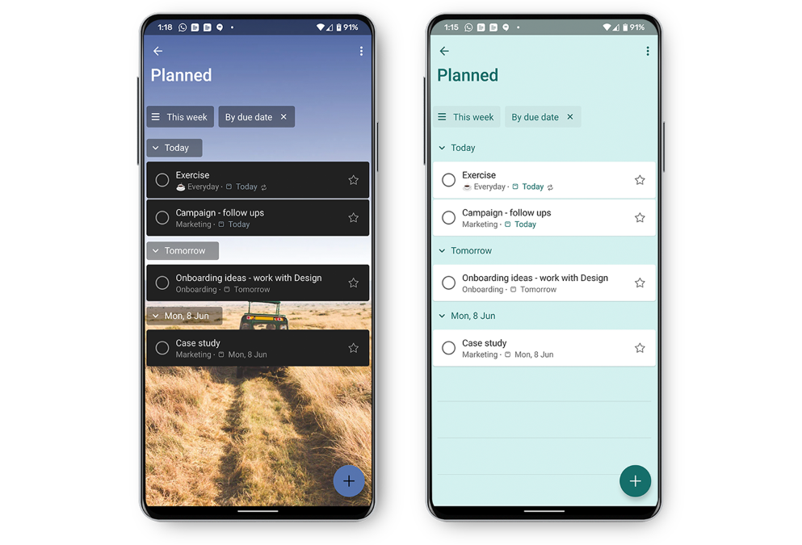
Outlook / To-Do
Personal Task Management
Turn emails into Tasks
Outlook or Mobile

